Slide 1
Week 4
Introduction to probability
Play with probability distributions in python
Genetic Algorithms

Slide 2
Probability Basics
Probability Theory and Concepts
Discrete probability Distributions
Continuous Probability Distributions

Slide 3
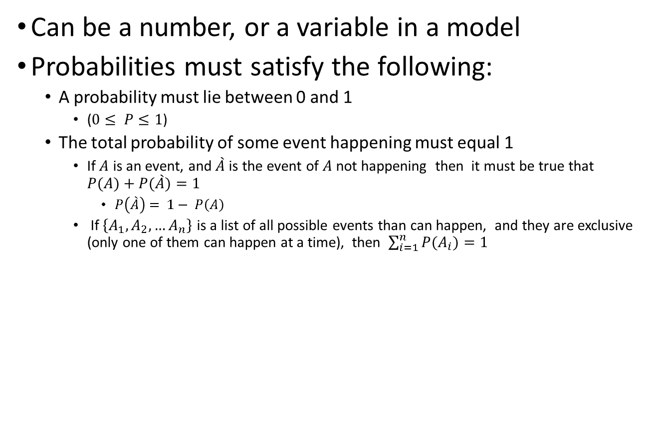
Probability is a measure of the chance that an event will occur
Can be a number, or a variable in a model
Probabilities must satisfy the following:
A probability must lie between 0 and 1
($0≤ P≤1$)
The total probability of some event happening must equal 1
If $A$ is an event, and $\grave{A}$ is the event of $A$not happening then it must be true that $P(A)+P(\grave{A})=1$
$P\left(\grave{A}\right)= 1− P\left(A\right)$
If $\left\{A_{1},A_{2},…A_{n}\right\}$ is a list of all possible events than can happen, and they are exclusive (only one of them can happen at a time), then $\sum_{i=1}^{n}{P(A_{i})=1}$

Slide 4
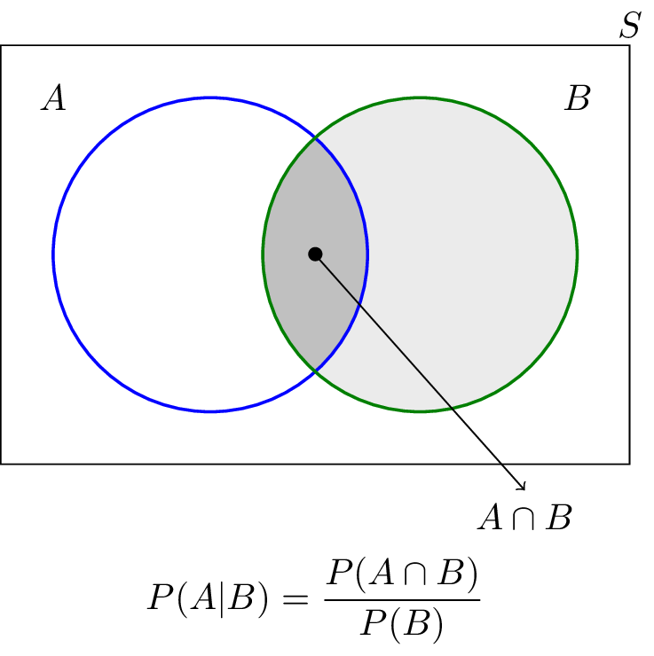
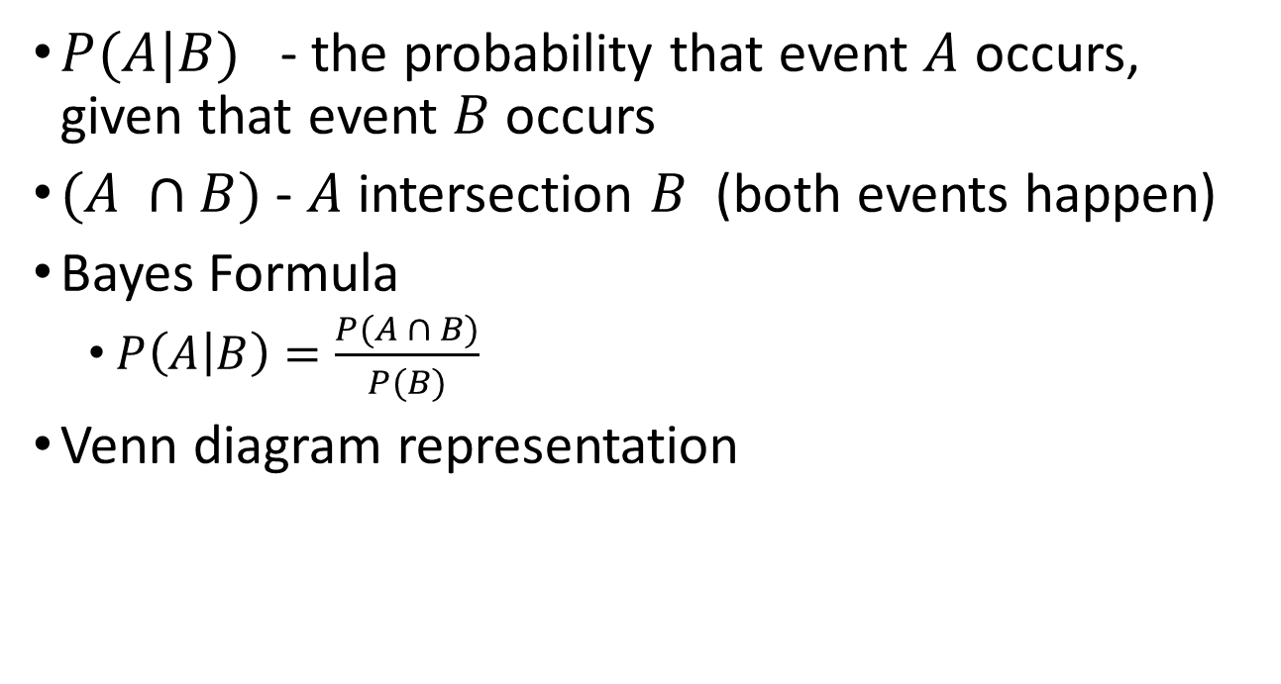
Conditional Probability
$P(A|B)$ - the probability that event $A$ occurs, given that event $B$ occurs
$(A ∩B)$ - $A$ intersection $B$ (both events happen)
Bayes Formula
$P\left(A | B\right)=\frac{P(A ∩ B)}{P(B)}$
Venn diagram representation

Slide 5
Discrete Probability Distribution
When the possible events are countable, either there are a finite number of them, or they are countably infinite
e.g. the number of games the Philadelphia Eagles will win during the regular season (16 games, so 16 possible values, each with a probability)
e.g. number of raisins in your next oatmeal cookie

Slide 6
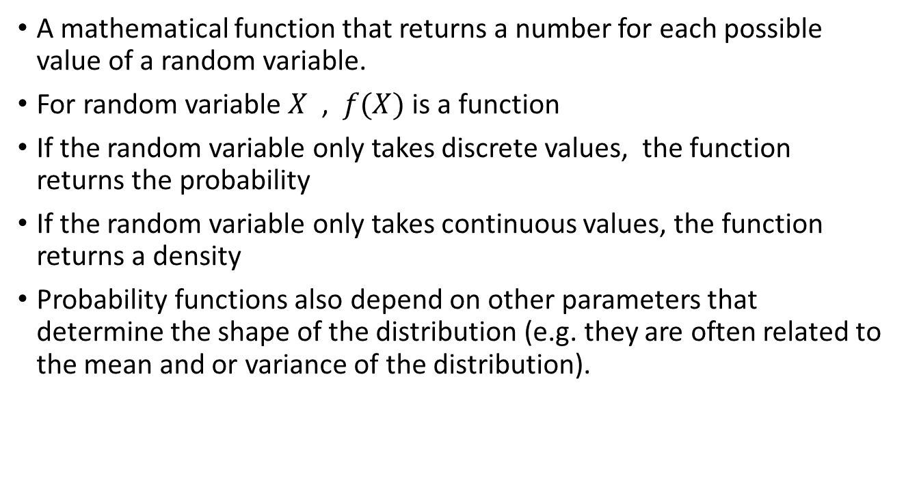
Probability function
A mathematical function that returns a number for each possible value of a random variable.
For random variable $X$ , $f(X)$ is a function
If the random variable only takes discrete values, the function returns the probability
If the random variable only takes continuous values, the function returns a density
Probability functions also depend on other parameters that determine the shape of the distribution (e.g. they are often related to the mean and or variance of the distribution).

Slide 7
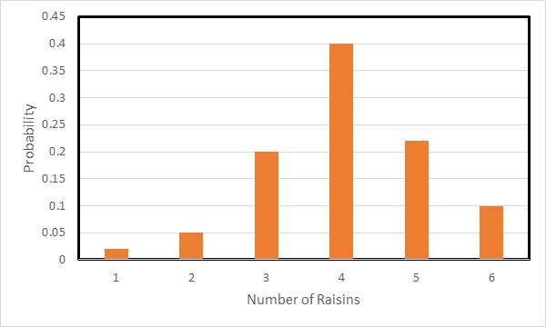
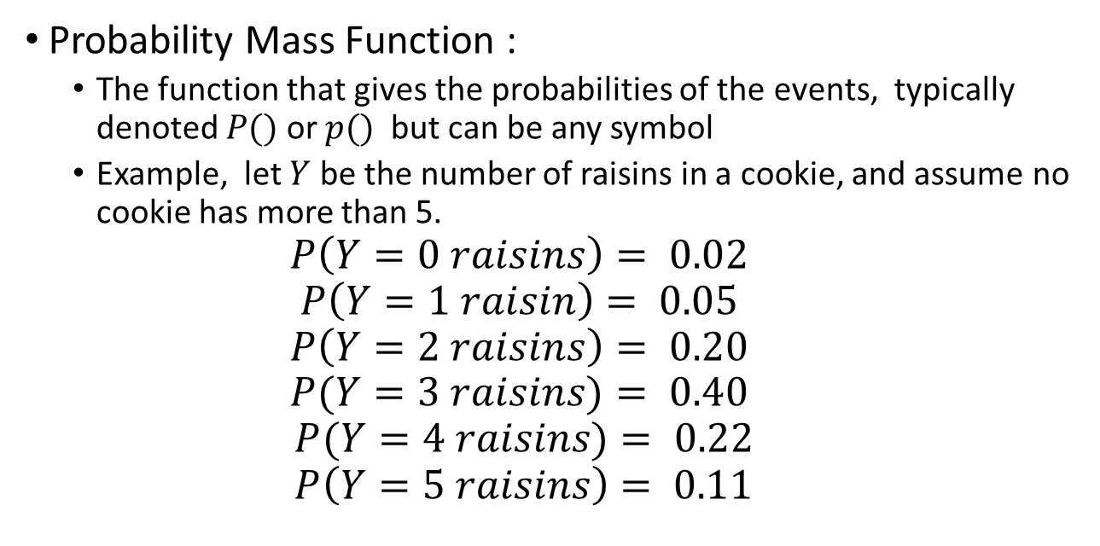
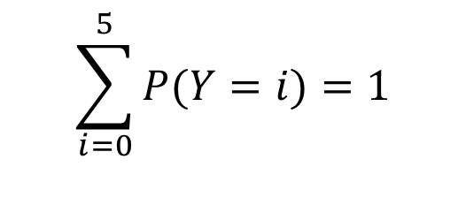
Discrete Probability Distribution
Probability Mass Function :
The function that gives the probabilities of the events, typically denoted $P()$ or $p()$ but can be any symbol
Example, let $Y$ be the number of raisins in a cookie, and assume no cookie has more than 5.
$$P\left(Y=0 raisins\right)= 0.02$$
$$P\left(Y=1 raisin\right)= 0.05$$
$$P\left(Y=2 raisins\right)= 0.20$$
$$P(Y=3 raisins)= 0.40$$
$$P(Y=4 raisins)= 0.22$$
$$P\left(Y=5 raisins\right)= 0.11$$
$$\sum_{i=0}^{5}{P(Y=i)}=1$$

Slide 8
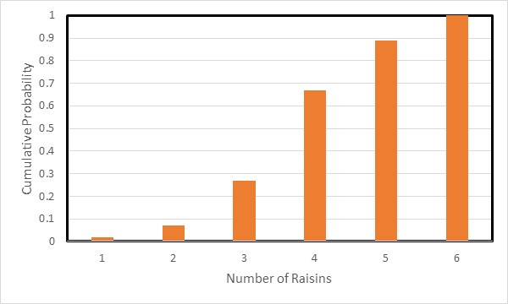
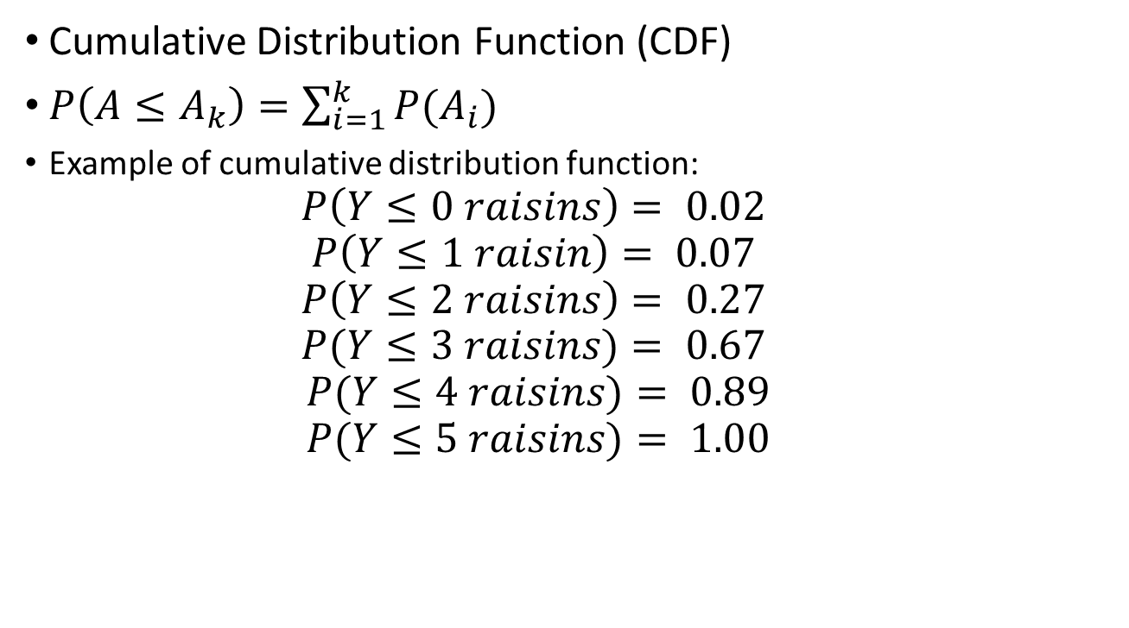
Discrete Probability Distribution
Cumulative Distribution Function (CDF)
$P\left(A≤A_{k}\right)=\sum_{i=1}^{k}{P(A_{i})}$
Example of cumulative distribution function:
$$P\left(Y≤0 raisins\right)= 0.02$$
$$P\left(Y≤1 raisin\right)= 0.07$$
$$P\left(Y≤2 raisins\right)= 0.27$$
$$P(Y≤3 raisins)= 0.67$$
$$P(Y≤4 raisins)= 0.89$$
$$P(Y≤5 raisins)= 1.00$$

Slide 9
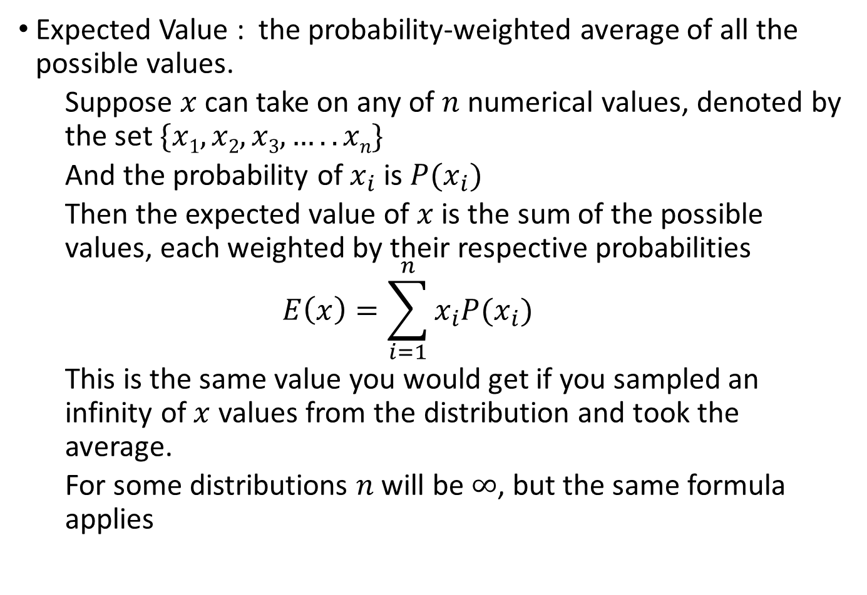
Expected Value of a Discrete Probability Distribution
Expected Value : the probability-weighted average of all the possible values.
Suppose $x$ can take on any of $n$ numerical values, denoted by the set $\{x1, x2, x3, …..xn\}$
And the probability of $x_{i}$ is $P(x_{i})$
Then the expected value of $x$ is the sum of the possible values, each weighted by their respective probabilities
$$E\left(x\right)=\sum_{i=1}^{n}{x_{i}P(x_{i})}$$
This is the same value you would get if you sampled an infinity of $x$ values from the distribution and took the average.
For some distributions $n$will be $∞$, but the same formula applies

Slide 10
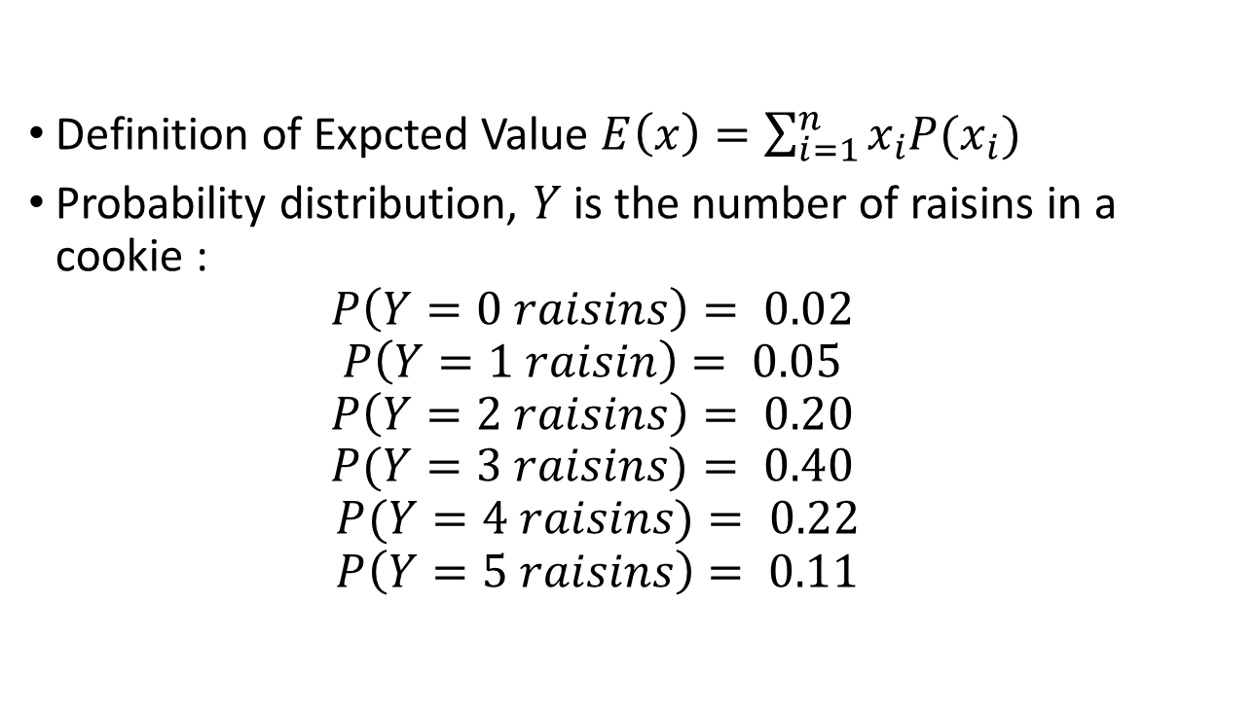

Expected value of the number of raisins in an l cookie
Definition of Expcted Value $E\left(x\right)=\sum_{i=1}^{n}{x_{i}P(x_{i})}$
Probability distribution, $Y$ is the number of raisins in a cookie :
$$P\left(Y=0 raisins\right)= 0.02$$
$$P\left(Y=1 raisin\right)= 0.05$$
$$P\left(Y=2 raisins\right)= 0.20$$
$$P(Y=3 raisins)= 0.40$$
$$P(Y=4 raisins)= 0.22$$
$$P\left(Y=5 raisins\right)= 0.11$$
$$\sum_{i=0}^{5}{P\left(Y=i\right)×i}=3.08$$
We can interpret the expected value in terms of what we would probably see if we examined a bunch of cookies, i.e. we’d expect that on average we would see about 3 raisins per cookie

Slide 11
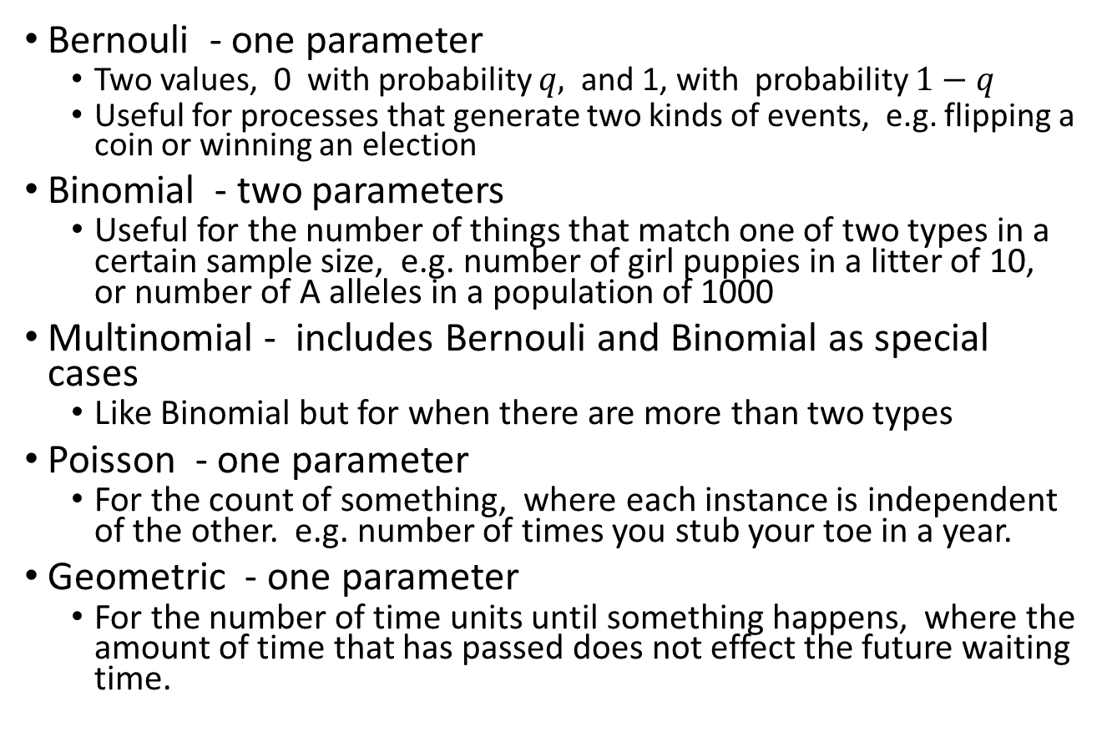
Some widely used discrete distributions
Bernouli - one parameter
Two values, 0 with probability $q,$ and 1, with probability $1−q$
Useful for processes that generate two kinds of events, e.g. flipping a coin or winning an election
Binomial - two parameters
Useful for the number of things that match one of two types in a certain sample size, e.g. number of girl puppies in a litter of 10, or number of A alleles in a population of 1000
Multinomial - includes Bernouli and Binomial as special cases
Like Binomial but for when there are more than two types
Poisson - one parameter
For the count of something, where each instance is independent of the other. e.g. number of times you stub your toe in a year.
Geometric - one parameter
For the number of time units until something happens, where the amount of time that has passed does not effect the future waiting time.

Slide 12
Bortkiewicz (1898). Famous example of the number of Prussian army soldiers killed in a year by being kicked by a horse (data collected over 10 Army Corps, for 20 years – 200 measurements)
Observed deaths | # counts
0 deaths : 109
1 death : 65
2 deaths: 22
3 deaths: 3
4 deaths : 1
> 4 deaths: 0
Mean number of deaths per year:
((0x109) + (1 x 65) + (2 x 22) + (3 x 33) + (4x 1))/200 = 0.61
Apply a Poisson Distribution – commonly used to model the number of rare random events.
The Poisson Distribution has one parameter.
Use the estimated mean of the data as the Poisson Parameter
Poisson Distribution with an Expected value of 0.61 events per year
# deaths | Probability |Expected # (200 counts)
0 0.5433 108.67
1 0.3314 66.28
2 0.1011 20.22
3 0.0206 4.11
4 0.0039 0.63
> 4 0.0004 0.08

Slide 13
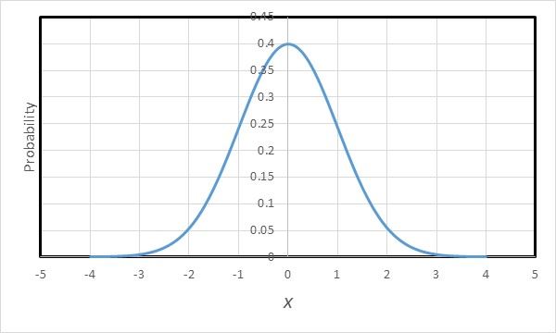
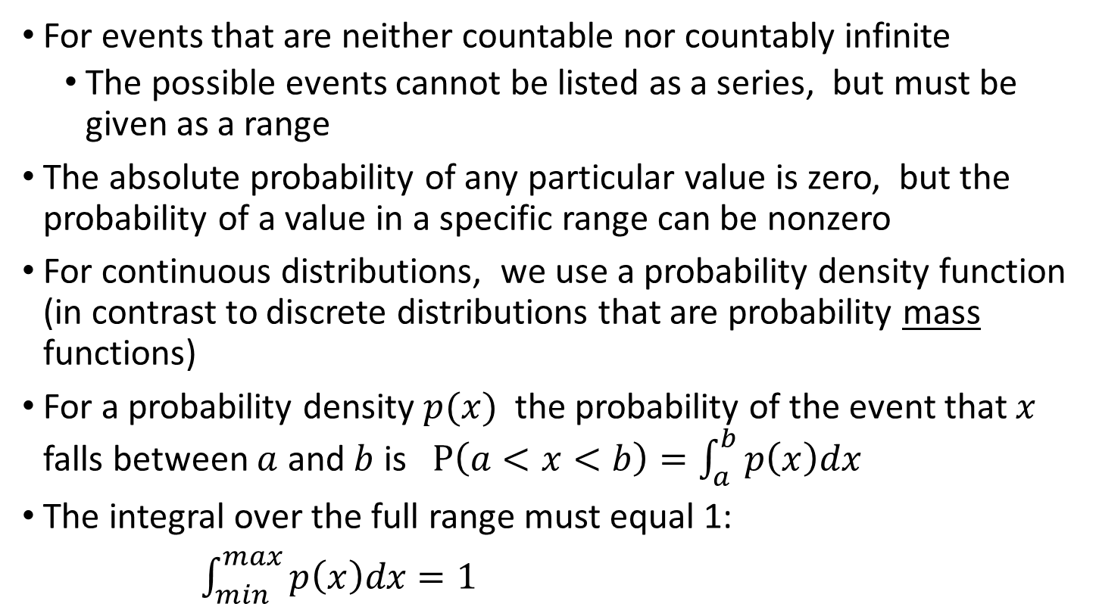
Continuous Probability Distributions
For events that are neither countable nor countably infinite
The possible events cannot be listed as a series, but must be given as a range
The absolute probability of any particular value is zero, but the probability of a value in a specific range can be nonzero
For continuous distributions, we use a probability density function (in contrast to discrete distributions that are probability mass functions)
For a probability density $p(x)$ the probability of the event that $x$ falls between $a$ and $b$ is $P\left(a<x<b\right)=\int_{a}^{b}{p\left(x\right)dx }$
The integral over the full range must equal 1:
$\int_{min}^{max}{p\left(x\right)dx=1 }$

Slide 14
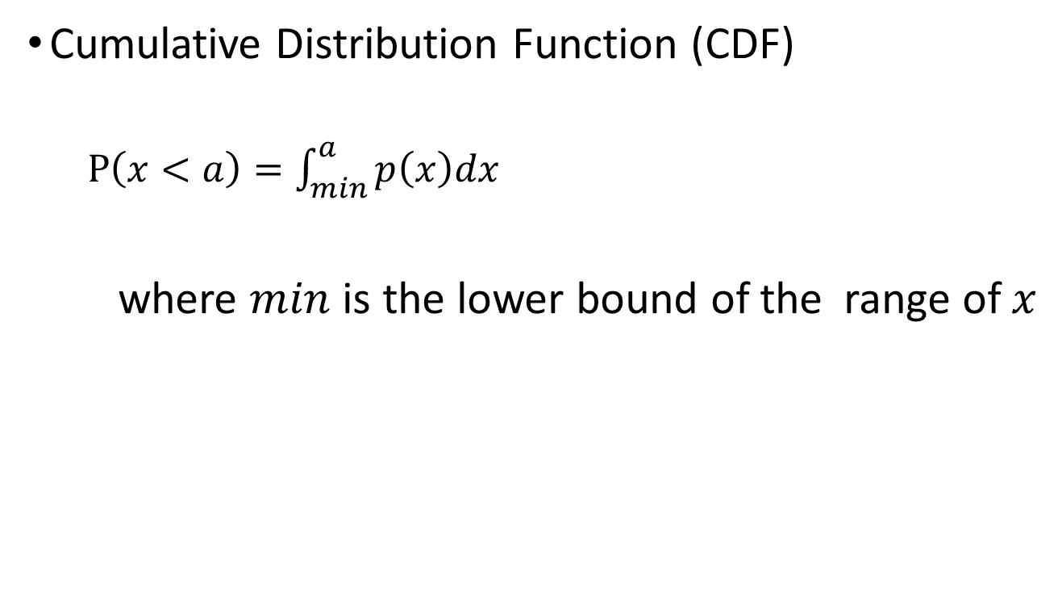
Continuous Probability Distributions
Cumulative Distribution Function (CDF)
$P\left(x<a\right)=\int_{min}^{a}{p\left(x\right)dx }$
where $min$ is the lower bound of the range of $x$

Slide 15
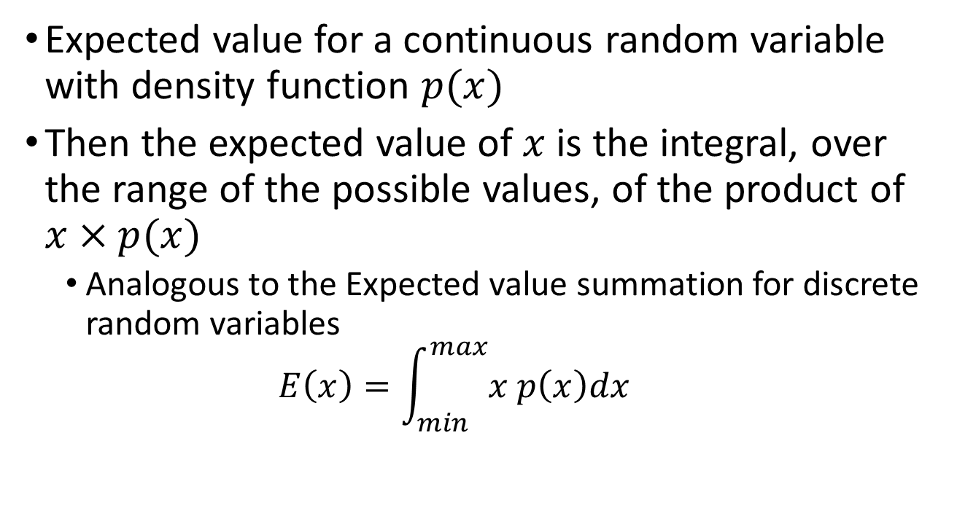
Continuous Probability Distributions
Expected value for a continuous random variable with density function $p(x)$
Then the expected value of $x$ is the integral, over the range of the possible values, of the product of $x×p(x)$
Analogous to the Expected value summation for discrete random variables
$$E\left(x\right)=\int_{min}^{max}{x p\left(x\right)dx }$$

Slide 16
Some common continuous probability distributions
Uniform – two parameters (beginning and end of the range)
Very useful in simulation random numbers from a uniform distribution can be easily used to generate random numbers from other distributions
Exponential – one parameter
Memoryless waiting time distribution
Used for Markov processes
Continuous version of geometric distribution
Gaussian (Normal) – two parameters
Many things follow a normal distribution
If the value of something is the sum of many independent contributions, that value will follow a normal distribution
Gamma - two parameters
The sum of one or more exponential distributions
Widely used

Slide 17
Examples using distributions in random module
Random module generates random values from several distributions

Slide 18
Genetic Algorithms- simulation-based approach to solving an optimization problem
Simulate a solution to the problem
not guaranteed to get the best answer
Can be very fast way to get a very good answer
Based on the concept of natural selection
Algorithm
Start with a random solution
Main loop (repeat until solution stops improving)
Make a random change to the solution
If the change makes the solution better, keep it
Else (the change makes the solution worse), keep it with some probability
Why does the algorithm include keeping some changes that make the solution worse?
To avoid getting stuck on a local optimum

Slide 19
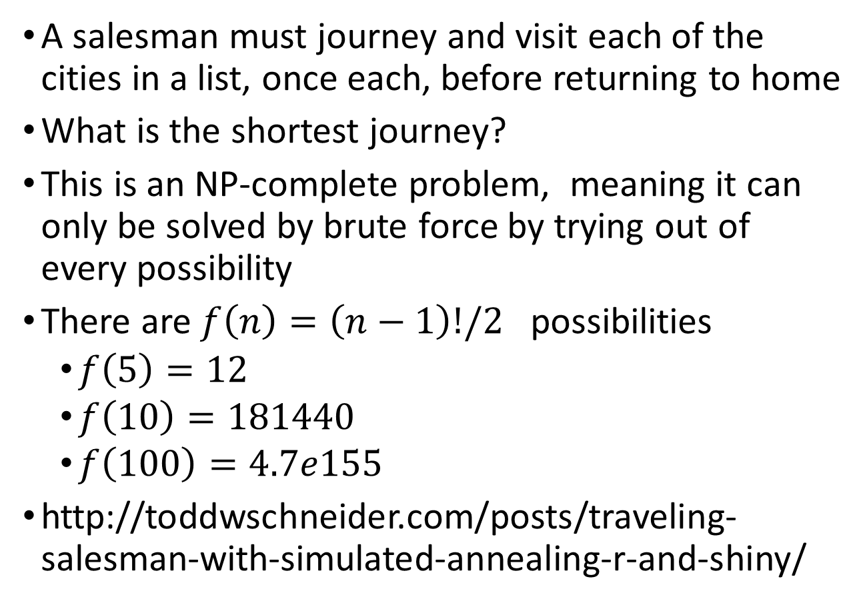
Traveling salesman problem (TSP)
A salesman must journey and visit each of the cities in a list, once each, before returning to home
What is the shortest journey?
This is an NP-complete problem, meaning it can only be solved by brute force by trying out of every possibility
There are $f\left(n\right)=\left(n−1\right)!/2$ possibilities
$f\left(5\right)=12$
$f\left(10\right)=181440$
$f\left(100\right)=4.7e155$
http://toddwschneider.com/posts/traveling-salesman-with-simulated-annealing-r-and-shiny/

Slide 20
Design a genetic algorithm to solve the TSP
If you were to write a program to “solve” the TSP using a genetic algorithm
Suppose you program has read in a list of the cities, and their geographic coordinates (latitude and longitude)
What are some functions your program will need
calcdis() - a function to calculate the distance between two cities, given their locations
totaldis() - A function that calls calcdis() and gets the total distance for the current list of cities
randomchangelist() – a function that proposes a change in the order of cities by making a change to the current order (e.g. swapping two cities)
decide_accept_change_or_not() – a function that compares totaldis() for the new list with totaldis() for the old list. If the new value is better it keeps the new list. If the new value is worse, it keeps it with some probability that is inversely proportional to how much worse the new list is.
Which of these functions is the most difficult to design?
Which of these functions is the second most difficult to design?

Slide 21
The Weasel program
Richard Dawkins – famous evolutionary biologist and author
Wrote “The Selfish Gene”
In his second book “The Blind Watchmaker”
Begins by describing William Paley’s famous argument for a creator
Dawkin’s used this as a stepping stone for describing the process whereby natural selection, acting on random variation, can lead to complicated life forms.
Introduces the “Weasel” program.
Simulate the creation of an English sentence
Use “Methinks it is like a weasel” from Shakespeare’s Hamlet
Simulates by starting with a random string of letters
Make random changes
Only keep changes if the new sentence is more similar to the target sentence.
This is an easy genetic algorithm
Not difficult to design a function to change the sequence
No need to worry about local optima – can always pick the new sequence if it is better
http://antievolution.org/cs/dawkins_weasel

Slide 22
Assignment Part 1
A Poisson Distribution takes 1 parameter
An exponential distribution takes 1 parameter
A Normal distribution takes 2 parameters
For each of these three distributions, research (i.e. read about) the mathematical relationship between the distribution parameter(s) and the mean and the variance of the probability distribution.
Write a program that simulates 1000 random values from each of these distributions
Use the following parameter values: Poisson: 5 Exponential : 0.5 and Normal: 10,5
You can use numpy.random.poisson() for Poisson
This returns a numpy array, use the list() method to make a regular list from it
You can use the random module for exponential and Normal (aka Gaussian)
For all three distributions, calculate the mean and the variance (or standard deviation) for the 1000 random variables
Compare the mean and variance of your sample to the values expected for the expectation and variance of that kind of distribution and the parameter(s) you used (that you got from your research.
Write an output file showing results for all three distributions, with a final comparison of calculated mean and variance, and the values expected for those distributions

Slide 23
Assignment Part 2
Write a weasel program to simulate “methinks it is like a weasel”
Start by simulating a random string of 28 letters and spaces
Create a loop to simulate new sequences:
Reproduce and Mutate: Make a new sequence by copying the current sequence, but with a chance of mistake (user specifies the probability of making a mistake). You can make one or more children.
Selection: Keep the new sequence if it is more similar to the target sequence, otherwise discard the new sequence. If you’ve made more than one children, keep only the best one.
Multiple Generations: Repeat until the simulated sequence equals the target.
Print the number of generations required to generate the target.
Some tips for the weasel program.
The string module has some useful stuff.
Break the problem into functions. Have a function for creating a child sequence (copy of parent with mutations). Have a function for measuring the difference between two sequences.

